Slide 1
SS ZG653 (RL 18): Software Architecture Architecture of Next Gen Systems- Software Architecture for Cloud Computing
Instructor: Prof. Santonu Sarkar
March 31, 2015

Slide 2
Quality Attributes
18.1

Slide 3
Quality of Service
Architecting a system meant for cloud platform is no different from other distributed platform
Issues of modifiability, interoperability, and testability are the same
What’s significantly different
Availability
Performance
Security

Slide 4
Availability
Services expected to always available- but there are many failure points
VM, PM, Network
Architect should plan for a failure
EC2 provides 99.95% availability, but how to plan for 0.05% failure?
Netflix – real time video streaming service
hosts on EC2 with additional application level availability
EC2 has 4 days of sporadic outage in 2011, but Netflix was unaffected

Slide 5
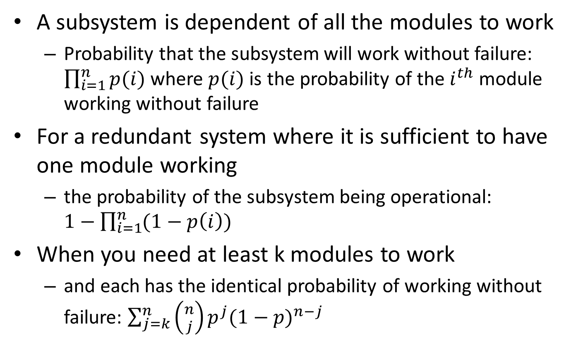
Failure Estimation
A subsystem is dependent of all the modules to work
Probability that the subsystem will work without failure: $\prod_{i=1}^{n}{p(i)}$ where $p(i)$ is the probability of the $i^{th}$ module working without failure
For a redundant system where it is sufficient to have one module working
the probability of the subsystem being operational: $1−\prod_{i=1}^{n}{(1−p\left(i\right))}$
When you need at least k modules to work
and each has the identical probability of working without failure: $\sum_{j=k}^{n}{\left({n \atop j}\right)p^{j}{(1−p)}^{n−j}}$

Slide 6
Netflix case study- Availability
Spare Copy tactic
Use of stateless service- any service request can be executed by any available server
Thus everyone can be a spare copy!
Active redundancy tactic
Amazon’s availability zone: Multiple redundant hot copies of data spread across Amazon provided availability zone
Graceful degradation tactic
Fail fast- use timeout so as to isolate from a failing component
Fallback- critical services degrade to a lower quality representation (similar to OS)
Feature removal- non-critical features are removed from being used

Slide 7
Performance
Assurance of business transaction SLA
Cloud can elastically add additional resource
Increase the VM capacity on-demand
Add additional VMs to divert the load
As an architect
It is necessary to understand Application’s resource demand and projected resource usage
Application should predict the load and possibly ask for more resource from the cloud resource manager

Slide 8
Security
Multi-tenancy in Cloud can increase security threat possibility
A PM is hosting other VMs alongwith yours
Information stealing
Each tenant’s virtual resource is ultimately mapped to a physical resource. Data from one tenant’s physical resource can get copied/moved to another tenant
VM escape
Though rare, an attacker can exploit hypervisor software error and access information by accessing VM address space
Side channel attack
Attacker can deduce the information about keys and other data by monitoring timing activity of another VM
Denial of Service
Malicious tenant grabs maximum resources so that other VMs starve for resource and that impacts service quality

Slide 9
Testing strategy Netflix- Simian Army
Uses test environments (called monkeys) to test
Latency: induces artificial delays in the communication to simulate service degradation and measures impact
Fault-Injection: Injects faults at several places of a running system to analyze the fault-tolerance
Helper utilities
Conformity: checks if a VM instance don’t adhere to best practices and shuts it down
E.g. Security: detects security violations or improper configuration
Improper configuration of security group, use of SSL, use of DRM
Health: monitors CPU load to detect overloaded VMs
Janitor: Removes unused resources

Slide 10
Multi-Tenant Architecture
18.2

Slide 11
Need existed long before SaaS
A Bank with many branches
Each branch should be able to access only its own data
Global changes should be possible- by adding a field to the master table
Local branch specific fields should also be possible to add
Global processing – like inter-bank reconciliation
Fine grained data centric access
High value transactions should be visible to special people in the bank
Special customer names should be invisible by default
This is exactly the need of today’s multi-tenant systems

Slide 12
Multi-Tenancy
Usually meant for hosted Software as a Service applications
Multi-tenancy - single code base; multiple customers
software development economies of scale driving down costs
rapid and invisible upgrades

Slide 13
Single schema model
Many early SaaS applications
Extra column: OU_ID indicates organization id
Each query is appended with OU_ID filter
Reengineering an existing application using single schema model is difficult
Difficult to have customer specific extensions
Additional metadata table needs to be created and handled in the application
Other fields of the table |  |  |  |  | OU_ID
 |  |  |  |  | Org1
 |  |  |  |  | Org1
 |  |  |  |  | Org1
 |  |  |  |  | Org2
 |  |  |  |  | Org2

Slide 14
Multi-tenancy-Single Schema
Name
Hobby
1. fetchCustomer (cname, ou)
Addr
2
Birthday
Value
ID | Name | Address | Value | OU_ID
100 |  |  |  | 503
101 |  |  |  | 490
102 |  |  |  | 503
4. update()
3. fetchCustomfields
(“Customer”, cname, ou)
Customer table
Entity | Custom_field | OU_ID | Key | Value
Customer | Hobby | 503 | 100 | Golf
Customer | Hobby | 503 | 102 | Tennis
Customer | Birthday | 503 | 102 | 10/10/72
Customer | Risk | 490 | 101 | High
Customer fields table

Slide 15
Multi Schema Model
Application computes the OU_ID and then switches to the appropriate database
Separate schema for each customer
One customer type has name, address, hobby, birthday
Another customer type has name, address, risk
Separate Metadata table for customization
Does not contain field-name-value pair for each customized record
Just the customization information

Slide 16
Multi-tenancy- Multiple Schema
1. fetchSchema (“Customer”, ou)
Name
Entity | Custom Field | OU_ID
Customer | Hobby | 503
Customer | Birthday | 503
Customer | Risk | 490
Hobby
Addr
Birthday
Value
2
3. update()
fetchCustomer(cname, ou) {
}
ID | Name | Address | Hobby | Birthday | Value
Customer schema for 503
ID | Name | Address | Risk | Value
Customer schema for 490

Slide 17
Multi-tenancy using Cloud Data Store
Google App Engine supports multi-tenancy anyway
User1’s datastore does not interfere with User2
Though underlying data structure is the same for User1, and User2
Suppose that you as application developer want to implement your own multi-tenancy on Google App Engine
Once you create a “Customer” kind, you can’t create it again!
You can leverage dynamic schema property of GFS to support this
If you use Python, at runtime you can create a class using type() function
Create subclasses of Customer such as Customer_503, Customer_490
ID | Name | Address | Hobby | Birthday | Value
Customer_503
ID | Name | Address | Risk | Value
Customer_490

Slide 18

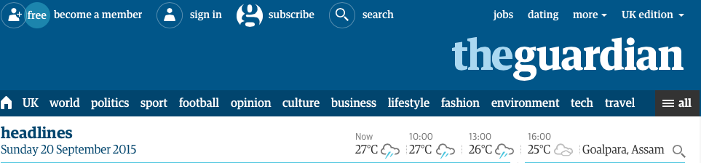


Microservices
Images and Content Ref:
http://martinfowler.com/articles/microservices.html
http://microservices.io/patterns/microservices.html
http://techblog.netflix.com/2012/07/embracing-differences-inside-netflix.html
Book: Releast It!
18.3

Slide 19
Microservice
An approach to develop an application as a suite of small components (modules)
Implements a business capability, independently deployable
Independently replaceable and upgradeable, hence loosely coupled
(Micro) Service
Collection of components provide a business functionality
Published Interface (read IEEE Software article by Fowler)
Out-of-process, runs in its own process and communicating lightly- REST style
Application
Collection of services, each service can be one or more processes
They are always built together
Use their own database
Many languages
Centralized management is limited and written in a different languages

Slide 20
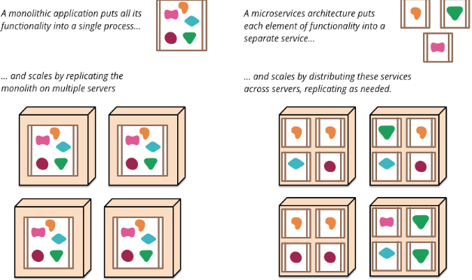
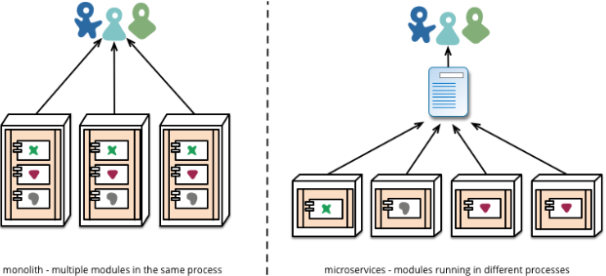
Monolith vs Microservice
Browser client
Load balanced WWW
App-server
Banking
front-end
AcctMgmt
MoneyXfer
RDBMS

Slide 21
Design Principle
Avoid Conway’s Law (design of system is a copy of the organization’s communication structure)
Create a service that is based on business functionality (with its own UI, business logic, database)
Smart endpoint, dumb pipe (i.e. as simple as a reliable message bus)
Classic Pipe-Filter model, Each service is a Filter,
Receive req. → process → produce response
REST, not BPEL, or SOAP
Decentralized Data Management
Infrastructure Automation
Design for Failure

Slide 22
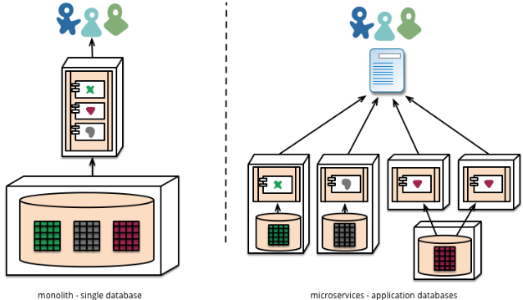
Data storage

Slide 23
Design of Data Persistence
Multiple types of data store, not necessarily Relational
Cons
Multiple technology -> Intergration problem (new interfaces)
Consistency and availability issues
Pros
Faster. When relational databases are used inappropriately, they exert a significant drag on application development.
Typical Design flaws:
Aplication was essentially composing and serving web pages. They only looked up page elements by ID
they had no need for transactions, and no need to share their database.
Much better suited to a key-value store than the relational db
Example: Gurdian website is rebuilt using MongoDB recently

Slide 24
Event Based Communication
MoneyXfer Svc
AcctMgmt Svc
Account
Id=101
Balance =195
Money Transfer
fromAcctID = 101
toAccountID = 202
amount = 55
State= COMPLETE
Account
Id=202
Balance =180
Publishes
moneyXferEvent
debitCompletedEvent
Subscribes to
moneyXferEvent
debitCompletedEvent
Subscribes to
acctDebitedEvent
acctCreditedEvent
Publishes
acctDebitedEvent
acctCreditedEvent
Message Bus

Slide 25
Transaction Consistency
To maintain consistency a microservice must atomically publish an event
Use datastore as a message
Update database: new entity state & event
Consume event & mark event as consumed
Eventually consistent mechanism
Replay events to recreate the state
No more 2PC
Implementation Difficulty
event publishing code and business logic is tangled
Account Table
AccountSvc
101
450
Balance: double
Open(initialAmt)
Debit(amount)
Credit(amount)
EventTable
e1
101
acctOpen
500
e1
101
acctCredit
250
e1
101
acctDebit
300

Slide 26
Architecture to Handle Failure
Since services can fail at any time
it's important to be able to detect the failures quickly and,
if possible, automatically restore service
Microservices based application put a lot of emphasis on real-time monitoring to check
architectural elements (how many requests per second is the database getting) and
business relevant metrics (such as how many orders per minute are received).
Semantic monitoring
can provide an early warning system of something going wrong
Can trigger development teams to follow up and investigate.
This is particularly important here as the application consists of a set micro-services collaborating through messages and events
Monitoring is vital to spot bad emergent behavior quickly so it can be fixed.

Slide 27
Fault-Tolerant Architecture Pattern
In Service oriented design, integration with external systems is essential
Many a times the failure is due to the problem of the external system
failures take several forms, ranging from various network errors to semantic errors
Error responses will be difficult to decipher
Errors can be protocol violation, slow response, or outright hang.
Fault-tolerant programming
Circuit Breaker, Timeouts will help in
Avoiding cascading failure
Can reduce the risk of DDOS attack on your service

Slide 28
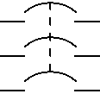
Patterns- Circuit Breaker
Closed
On call→ pass through
Call success→ count=0
Call fail→ count++
Critical calls (incoming or outgoing) is wrapped with a circuit breaker- which is in a normal “closed” state
If the call succeeds, nothing extraordinary happens.
If it fails, however, the circuit breaker makes a note of the failure.
Once the # failures (or frequency of failures, in more sophisticated cases) exceeds a threshold the circuit breaker trips and “opens” the circuit
Then the call fails immediately and i) a notificaiton is sent to the caller as well as an alert is sent
After sometime, the state is reset to CLOSED thinking that the problem is fixed
Open
On call→fail
Start timer
call success
call fail
timeout
Half-open
On call→ pass through

Slide 29
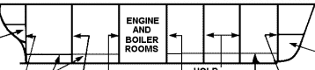
Pattern- Bulkhead
Foo
Bar
Foo and Bar are two (micro)services who depend on a common service Baz
If foo() crashes, or consumes excessive resource, or compromised, or triggers a bug in Baz, Bar() will also suffer. Hence Partition Bazz
Baz
Capacity Planning
If Foo, Bar and Bazz use the same resource pools and if there resource demands are known, a shared pool is more cost effective
Use VMs for load-balancing and implementing this pattern
Foo
Bar
Baz
Baz Pool1
Baz Pool2

Slide 30
Pattern - Timeout
The timeout is a simple mechanism to break from waiting for an answer beyond certain point.
Typically external call, network calls
Asynchronous calls are often too complex for a particular situation
Well-placed timeouts provide fault isolation
Unfortunately, with higher levels of abstraction, explicit timeout is not present in any Program level APIs
Vendor-provided client libraries are devoid of timeouts
These libraries hides a socket communication and prevent setting timeouts.
Timeouts can also be relevant within a single application- specifically in multi-threaded application

Slide 31
Scalable Deployment
AcctMgmt Svc
MoneyXfer Svc
Y
Partitioned services
(login, browse, checkout
Event based communication
Message Bus
Partitioned data
(A-F)(F-R)
(S-Z)
Z
Acct DB
Xfer DB
Acct 101
Txn1:
From: 101
To: 202
Amt: 75
Status: DONE
Acct 202
Monolithic Single System
(all customer data A-Z)
X
Set of redundant, load balanced clones
(clones of customer data)
Example of bulkhead

Slide 32
CAP Theorem
18.4

Slide 33
CAP Theorem
No distributed system can achieve all of the three properties
Consistency
The data will be consistent throughout the distributed system
Availability
The data will always be available
Partition Tolerance
The system will not fail when network is partitioned

Slide 34
CAP Theorem- Explanation
Imagine a distributed system which keeps track of a single piece of data using three nodes—A, B, and C—and which claims to be both consistent and available. Misfortune strikes, and that system is partitioned into: {A,B} and {C}. Now a write request arrives at C.
Accept the write, knowing that neither A nor B will know about this new data until the partition heals.
Refuse the write, knowing that the client might not be able to contact A or B until the partition heals.
Choosing Consistency Over Availability
It has to guarantee atomic reads and writes by refusing to respond to some requests. It may decide to shut down entirely (like the clients of a single-node data store), refuse writes (like Two-Phase Commit), or only respond to reads and writes for pieces of data whose “master” node is inside the partition component
Choosing Availability Over Consistency
It will respond to all requests, potentially returning stale reads and accepting conflicting writes. These inconsistencies are often resolved via causal ordering mechanisms like vector clocks and application-specific conflict resolution procedures.
Dynamo systems usually offer both of these
Cassandra’s hard-coded Last-Writer-Wins conflict resolution being the main exception

Slide 35
Architect’s Decision
How do we tradeoff between C, A, and P?
Eventual Consistency
Nodes across partitions are allowed to be inconsistent- for some time- then it becomes consistent
Architect’s decision- Design challenge
No more than n% of data should be stale
It shouldn’t take more than t sec. to be consistent
Availability and Partition tolerance (latency) is preferred than consistency
Facebook user should always be able to respond but they are okay with delayed newsfeed
Amazon shopping cart does not require ACID property
Twitter timelines may be delayed
Fund-transfer between Banks- delay of 24hrs is okay

Slide 36
Architect’s Role
Mechanism for eventual consistency
Caching, replication, message retry, timeout
Quality Attribute Tradeoff
NoSQL databases must trade-off between
Availability, latency, consistency , partitioning
Additionally
Interoperability, security

Slide 37
Thank You

